Slide 1
The Visual Basic Language
You’ll learn about:-
data types
the operations
define functions, loops, and conditional logic

Slide 2
Variables and Data Types
Give the variable a name and specify the type of data it will store
Use the Dim statement to declare a local variable
Examples,
' Declare an integer variable named ErrorCode.
Dim ErrorCode As Integer
' Declare a string variable named MyName.
Dim MyName As String

Slide 3
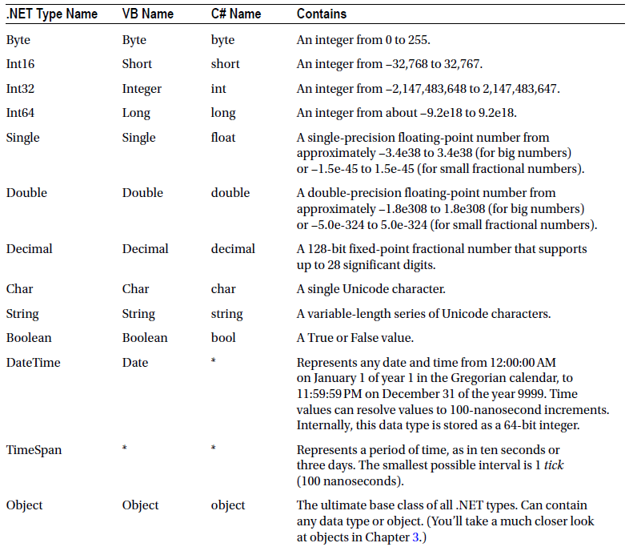
Common Data Types

Slide 4
Assignment and Initializers
Assigning values to variables
' Declare variables.
Dim ErrorCode As Integer
Dim MyName As String
' Assign values.
ErrorCode = 10
MyName = "Matthew"

Slide 5
Assignment and Initializers
Assigning a value to a variable in the same line that it is declared:-
Dim ErrorCode As Integer = 10
Dim MyName As String = "Matthew"

Slide 6
Can use simple data types without initializing them.
Numbers are automatically initialized to 0, and strings are initialized to an empty string ("").
Example,
Dim Number As Integer ' Number now contains 0.
Number = Number + 1 ' Number now contains 1.

Slide 7
Arrays
Arrays allow you to store a series of values that have the same data type.
All arrays start at a fixed lower bound of 0.
When you create an array in VB, you simply specify the upper bound
Example,
' Create an array with four strings (from index 0 to index 3).
Dim StringArray(3) As String
' Create a 2 x 4 grid array (with a total of eight integers).
Dim IntArray(1, 3) As Integer

Slide 8
Fill an array with data at the same time when it is created.
Example,
' Create an array with four strings, one for each number from 1 to 4.
Dim StringArray() As String = {"1", "2", "3", "4"}
' Create a 4 x 2 array (a grid with four rows and two columns).
Dim IntArray(,) As Integer = {{1, 2}, {3, 4}, {5, 6}, {7, 8}}

Slide 9
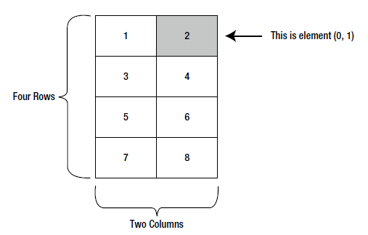
A sample two-dimensional array of integers

Slide 10
Specify the corresponding index number in parentheses to access an element in the array.
Example 1,
Dim IntArray() As Integer = {1, 2, 3, 4}
Dim Element As Integer
Element = IntArray(2) ' Element is now set to 3.
Example 2,
Dim IntArray(,) As Integer = {{1, 2}, {3, 4}, {5, 6}, {7, 8}}
' Access the value in row 0 (first row), column 1 (second column).
Dim Element As Integer
Element = IntArray(0, 1) ' Element is now set to 2.

Slide 11
Use the ReDim keyword to resize an array.
Example,
Dim MyArray(10, 10) As Integer
ReDim MyArray(20, 20)
Use the optional Preserve keyword when redimensioning the array to preserve the contents.
Example,
Dim MyArray(10, 10) As Integer
ReDim Preserve MyArray(10, 20) ' Allowed, and the contents will remain.
ReDim Preserve MyArray(20, 20) ' Not allowed. A runtime error will occur.
' Only the last dimension can be changed.

Slide 12
The ArrayList
The ArrayList is a collection class.
Allows dynamic resizing.
A snippet of VB code that uses an ArrayList:
' Create an ArrayList object. It's a collection, not an array,
' so the syntax is slightly different.
Dim DynamicList As New ArrayList()
' Add several strings to the list.
' The ArrayList is not strongly typed, so you can add any data type
' although it's simplest if you store just one type of object
' in any given collection.
DynamicList.Add("one")
DynamicList.Add("two")
DynamicList.Add("three")
' Retrieve the first string. Notice that the object must be converted to a
' string, because there's no way for .NET to be certain what it is.
Dim Item As String = CType(DynamicList(0), String)

Slide 13
Enumerations
An enumeration is a group of related constants, each of which is given a descriptive name.
Example,
' Define an enumeration called UserType with three possible values.
Enum UserType
Admin
Guest
Other
End Enum
' Create a new value and set it equal to the UserType.Admin constant.
Dim NewUserType As UserType
NewUserType = UserType.Admin

Slide 14
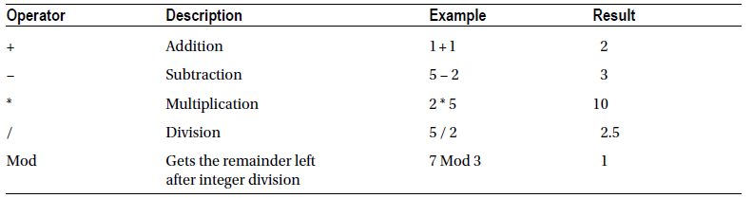
Variable Operations
Arithmetic Operations

Slide 15
Example,
Dim Number As Integer
Number = 4 + 2 * 3
' Number will be 10.
Number = (4 + 2) * 3
' Number will be 18.

Slide 16
Use the concatenation operator (&) to join two strings
Example,
' Join two strings together. Could also use the + operator.
MyName = FirstName & " " & LastName

Slide 17
Special shorthand assignment operators
Example,
' Add 10 to MyValue (the same as MyValue = MyValue + 10).
MyValue += 10
' Multiply MyValue by 3 (the same as MyValue = MyValue * 3).
MyValue *= 3
' Divide MyValue by 12 (the same as MyValue = MyValue / 12).
MyValue /= 12

Slide 18
LINE TERMINATION
Can break a code statement over multiple lines by adding a space followed by the line-continuation character (an underscore) to the end of the line
Example,
' A long line of code.
MyValue = MyValue1 + MyValue2 + MyValue3
' A code statement split over several lines in VB.
MyValue = MyValue1 + MyValue2 + _
MyValue3

Slide 19
Advanced Math
Performing calculations using the Math class,
Dim MyValue As Double
MyValue = Math.Sqrt(81) ' MyValue = 9.0
MyValue = Math.Round(42.889, 2) ' MyValue = 42.89
MyValue = Math.Abs(−10) ' MyValue = 10.0
MyValue = Math.Log(24.212) ' MyValue = 3.18.. (and so on)
MyValue = Math.PI ' MyValue = 3.14.. (and so on)

Slide 20
Type Conversions
Type conversion is converting information from one data type to another.
VB allows automatic or implicit data type conversions but this feature can be disabled by adding an Option Strict instruction to the beginning of your code files.
Option Strict On
Two types of conversion: widening and narrowing.
Widening conversions always succeed. Example, converting a number into a string, or a 16-bit integer into a 32-bit integer.
Narrowing conversions may or may not succeed, depending on the data.
Converting a 32-bit integer to a 16-bit integer could result in a runtime error if the 32-bit number is larger than the maximum value that can be stored in the 16-bit data type.

Slide 21
Use the CType() function to perform an explicit data type conversion
Example,
Dim BigValue As Integer = 100
Dim SmallValue As Short
Dim MyText As String = "100"
' Explicitly convert your 32-bit number into a 16-bit number.
SmallValue = CType(BigValue, Short)
' Explicitly convert your string into a number.
BigValue = CType(MyText, Integer)
Can also use the classic Visual Basic keywords such as Val(), CStr(), CInt(), CBool(), and so on to performdata type conversions with the standard data types.

Slide 22
Object-Based Manipulation
Every type in the .NET class library includes a ToString() method.
Example,
Dim MyString As String
Dim MyInteger As Integer = 100
' Convert a number to a string. MyString will have the contents "100".
MyString = MyInteger.ToString()

Slide 23
The String Type
Several ways to manipulate a string by using the methods in the String type:
Dim MyString As String = "This is a test string "
MyString = MyString.Trim() ' = "This is a test string"
MyString = MyString.Substring(0, 4) ' = "This"
MyString = MyString.ToUpper() ' = "THIS"
MyString = MyString.Replace("IS", "AT") ' = "THAT"
Dim Length As Integer = MyString.Length ' = 4

Slide 24
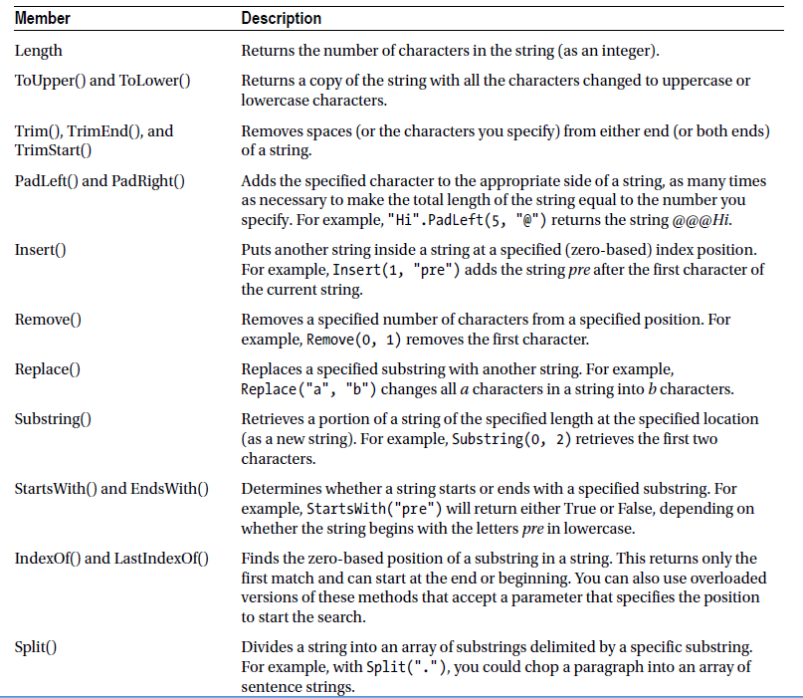
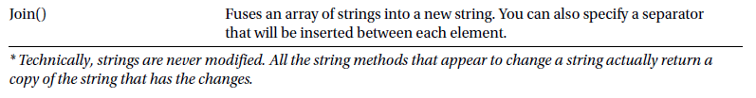
Useful String Members*

Slide 25
The DateTime and TimeSpan Types
Can be used to perform three useful tasks:-
Extract a part of a DateTime (for example, just the year) or convert a TimeSpan to a specific representation (such as the total number of days or total number of minutes)
Easily perform date and time calculations
Determine the current date and time and other information (such as the day of the week or whether the date occurs in a leap year)

Slide 26
Example 1,
Dim MyDate As DateTime = DateTime.Now
MyDate = MyDate.AddDays(100)
Dim DateString As String = MyDate.Year.ToString()
Example 2,
Dim MyDate1 As Date = DateTime.Now
Dim MyDate2 As Date = DateTime.Now.AddHours(3000)
Dim Difference As TimeSpan
Difference = MyDate2.Subtract(MyDate1)
Dim NumberOfMinutes As Double
NumberOfMinutes = Difference.TotalMinutes

Slide 27
The DateTime and TimeSpan classes also support the + and – arithmetic operators.
Example,
Dim MyDate1 As DateTime = DateTime.Now
Dim Interval As TimeSpan = TimeSpan.FromHours(3000)
Dim MyDate2 As DateTime = MyDate1 + Interval
' Subtracting one DateTime object from another produces a TimeSpan.
Dim Difference As TimeSpan
Difference = MyDate2 - MyDate1

Slide 28
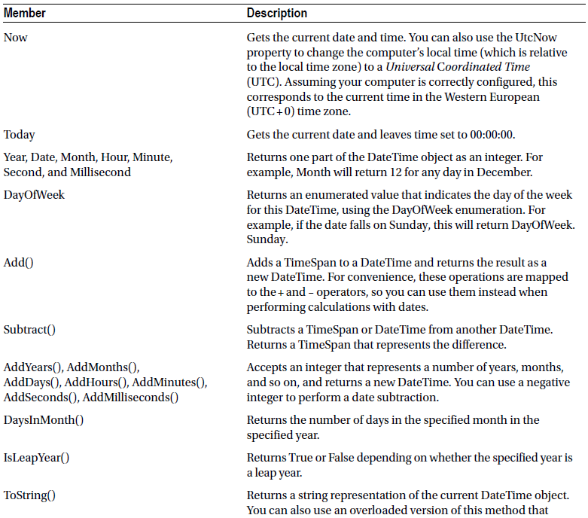
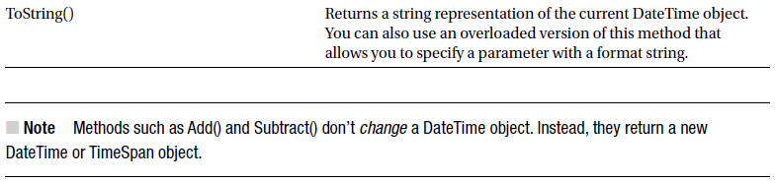
Useful DateTime Members

Slide 29
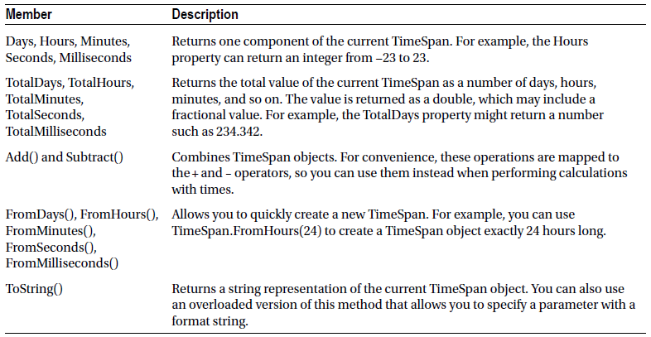
Useful TimeSpan Members

Slide 30
The Array Type
Every array is an instance of the System.Array type.
Built-in features include the Length property, GetLength() method, GetUpperBound() method, etc.
Example 1,
Dim MyArray() As Integer = {1, 2, 3, 4, 5}
Dim NumberOfElements As Integer
NumberOfElements = MyArray.Length ' NumberOfElements = 5
Example 2,
Dim MyArray() As Integer = {1, 2, 3, 4, 5}
Dim Bound As Integer
' Zero represents the first dimension of an array.
Bound = MyArray.GetUpperBound(0) ' Bound = 4

Slide 31
In the case of a one-dimensional array, you must always specify 0 to get the index number from the first dimension. In a twodimensional array, you can also use 1 for the second bound; in a three-dimensional array, you can also use 2 for the third bound; and so on.

Slide 32
Example 3,
' Create a 4 x 2 array (a grid with four rows and two columns).
Dim IntArray(,) As Integer = {{1, 2}, {3, 4}, {5, 6}, {7, 8}}
Dim Rows, Columns As Integer
Rows = IntArray.GetUpperBound(0) + 1 ' Rows = 4
Columns = IntArray.GetUpperBound(1) + 1 ' Columns = 2

Slide 33
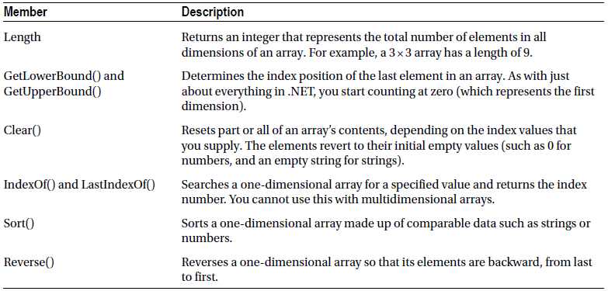
Useful Array Members

Slide 34
Conditional Logic
All conditional logic starts with a condition: a simple expression that can be evaluated to True or False.
To build a condition, you can use any combination of literal values or variables along with logical operators.

Slide 35
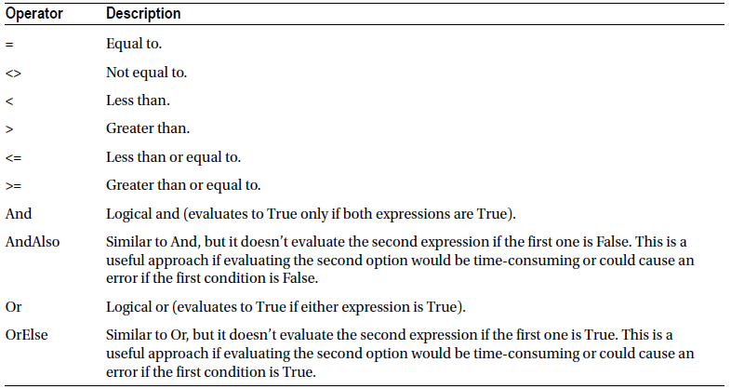
Logical Operators
* A string is deemed to be “less than” another string if it occurs earlier in an alphabetic sort. Thus apple is less than attach.

Slide 36
The If . . . End If Block
Example,
If MyNumber > 10 Then
' Do something.
ElseIf MyString = "hello" Then
' Do something.
Else
' Do something.
End If

Slide 37
The Select Case Block
Can be used to evaluate a single variable or expression for multiple possible values
Example 1,
Select Case MyNumber
Case 1
' Do something if MyNumber = 1.
Case 2
' Do something if MyNumber = 2.
Case Else
' Do something if MyNumber is anything else.
End Select
Example 2,
Select Case MyNumber
Case 1, 2
' Do something if MyNumber = 1 Or MyNumber = 2.
Case Else
' Do something if MyNumber is anything else.
End Select

Slide 38
Loops
Three basic types of loops:-
loop a set number of times with a For . . . Next loop.
loop through all the items in a collection of data by using a For Each loop.
loop until a certain condition is met, using a Do . . . Loop.

Slide 39
The For . . . Next Block
Example 1,
Dim i As Integer
For i = 1 To 10 Step 1
' This code executes 10 times.
Debug.Write(i & " ")
Next
Example 2,
For i As Integer = 1 To 10
' This code executes 10 times.
Debug.Write(i & " ")
Next

Slide 40
Example 3,
Dim StringArray() As String = {"one", "two", "three"}
For i As Integer = 0 To StringArray.GetUpperBound(0)
Debug.Write(StringArray(i) & " ")
Next

Slide 41
The For Each Block
Example,
Dim StringArray() As String = {"one", "two", "three"}
For Each Element As String In StringArray
' This code loops three times, with the Element variable set to
' "one", then "two", and then "three".
Debug.Write(Element & " ")
Next

Slide 42
The Do . . . Loop Block
Example 1,
Dim i As Integer = 0
Do
i += 1
' This code executes 10 times.
Loop While i < 10
Example 2,
Dim i As Integer = 0
Do While i < 10
i + = 1
' This code executes 10 times.
Loop

Slide 43
Methods
There are two types of methods: subroutines and functions
Functions return a value, while subroutines do not.
Subroutines are declared with the Sub keyword, and functions are declared with the Function keyword.
Example 1,
' This method doesn't return any information.
Private Sub MySub()
' Code goes here.
End Sub

Slide 44
Example 2,
' This method returns an integer.
Private Function MyFunc() As Integer
' As an example, return the number 10.
Return 10
End Function

Slide 45
Calling a method
Example,
' This call is allowed.
MySub()
' This call is allowed.
MyFunc()
' This call is allowed.
Dim MyNumber As Integer
MyNumber = MyFunc()
' This call isn't allowed.
' MySub does not return any information.
MyNumber = MySub()

Slide 46
Parameters
Example of a function that accepts two parameters and returns their sum:
Private Function AddNumbers(number1 As Integer, number2 As Integer) _
As Integer
Return number1 + number2
End Sub

Slide 47
Method Overloading
Can create more than one method with the same name but with a different set of parameters
Example,
Private Overloads Function GetProductPrice(id As Integer) As Decimal
' Code here.
End Function
Private Overloads Function GetProductPrice(name As String) As Decimal
' Code here.
End Function
' And so on...

Slide 48
Optional parameters.
Add the keyword Optional before the parameter name and assign a default value.
If the method has normal parameters and optional parameters, the optional parameters must be placed at the end of the parameter list.
Example,
Private Function GetUserName(ByVal ID As Integer, _
Optional ByVal useShortForm As Boolean = False) As String
' Code here.
End Function

Slide 49
Example of calling the method with optional parameter:-
' Explicitly set the useShortForm parameter.
Name = GetUserName(401, True)
' Don't set the useShortForm parameter, and use the default value (False).
Name = GetUserName(401)

Slide 50
Multiple optional parameters
Example,
Private Function GetSalesTotalForRegion(ByVal regionID As Integer, _
Optional ByVal minSale As Decimal = 0, _
Optional ByVal maxSale As Decimal = Decimal.MaxValue, _
Optional ByVal includeTax As Boolean = False) As Decimal
' Code here.
End Function

Slide 51
Example of calling a method with multiple optional parameters:-
Total = GetSalesTotalForRegion(523, maxSale:=5000)
Pick the parameters you want to set by name. This feature is called named parameters.
Add the parameter name followed by a colon and equal sign (:=), followed by the value

Slide 52
Delegates
Delegates allow you to create a variable that “points” to a method.
Flexible code that can be reused in many situations
The basis for events
Step 1: Define its signature.
Private Function TranslateEnglishToFrench(English As String) As String
' Code goes here.
End Function
Step 2: Define a delegate type that matches this signature
Private Delegate Function StringFunction(inputText As String) As String
Step 3: Create and assign a delegate variable
Dim FunctionReference As StringFunction

Slide 53
Step 4: Using your delegate variable (point to any method that has the matching signature)
FunctionReference = AddressOf TranslateEnglishToFrench
Step 5: Invoke the function through the delegate
Dim FrenchString As String
FrenchString = FunctionReference("Hello")

Slide 54
Events are based on delegates but work at a slightly higher level.
Events are used extensively in a typical ASP.NET application.

